Slide 1
PO Copy Download
Development Document
Ken Wang
Aug, 2019

Slide 2
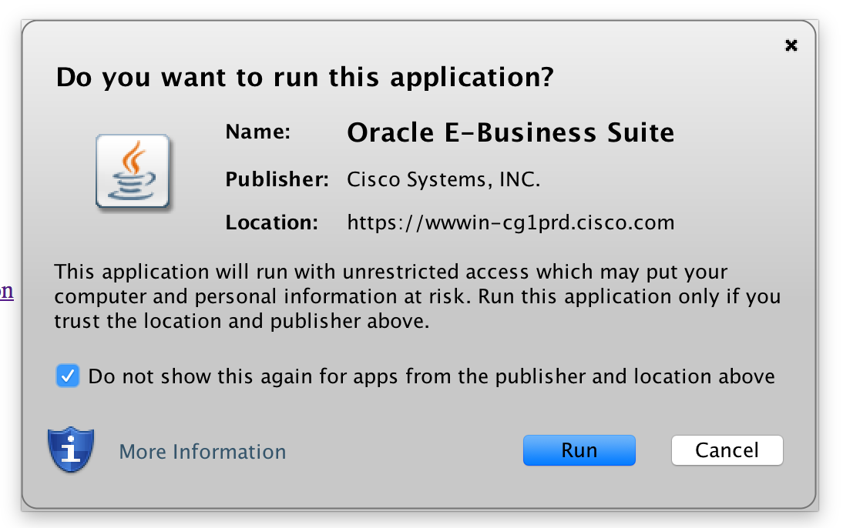
Pre-requisition
确保以下默认选项被选中，以后不要出现以下窗口。

Slide 3
URL
https://wwwin-cg1prd.cisco.com:443/OA_HTML/RF.jsp?function_id=75&resp_id=51179&resp_appl_id=201&security_group_id=0&lang_code=US

Slide 4
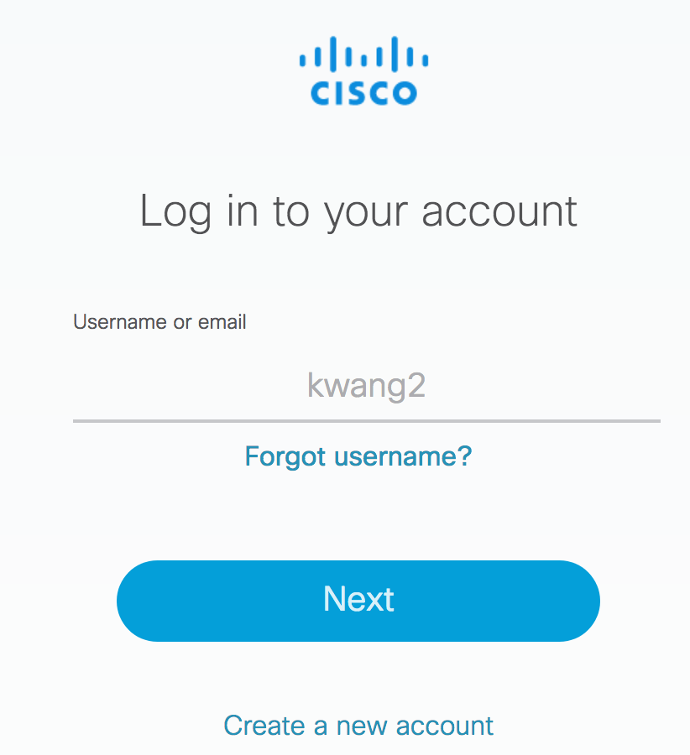
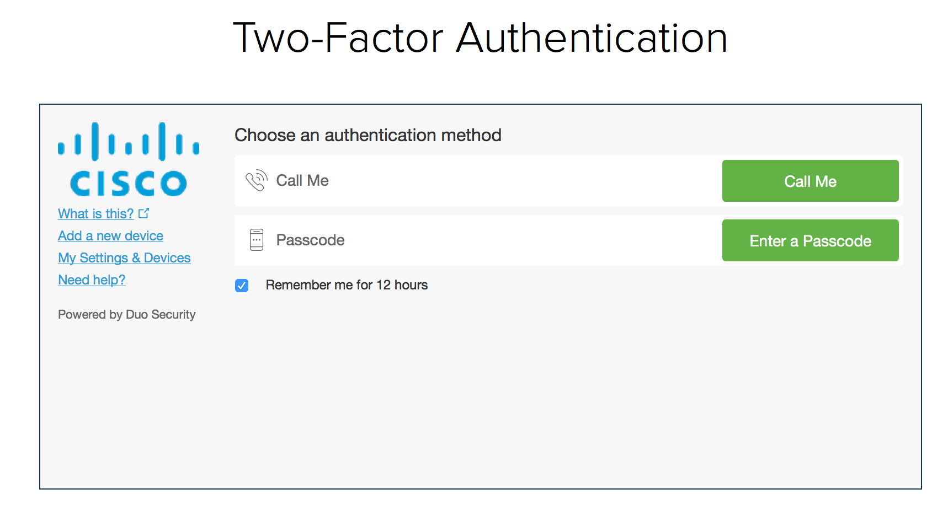
Log on Window
Check window:
If user log window, then delete user/pw and enter new ones (expect a common user/pw); or just used saved default)
If Duo window, then use call me option to log on
If Oracle start window (step 1: OK button: 383 444 (211, 228, 244, 255))

Slide 5
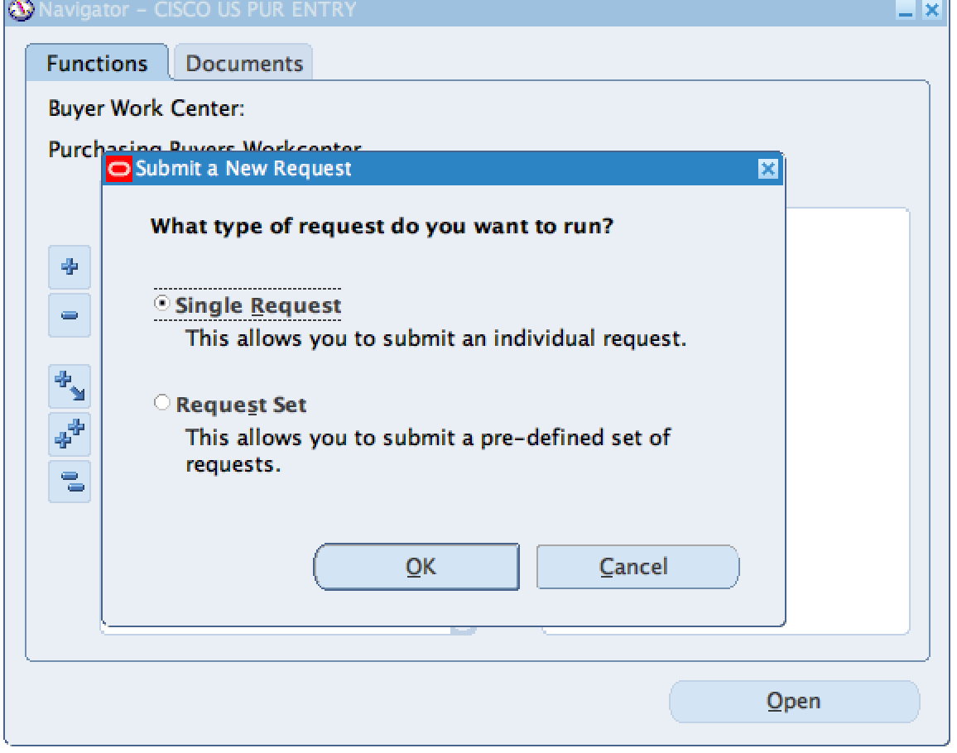
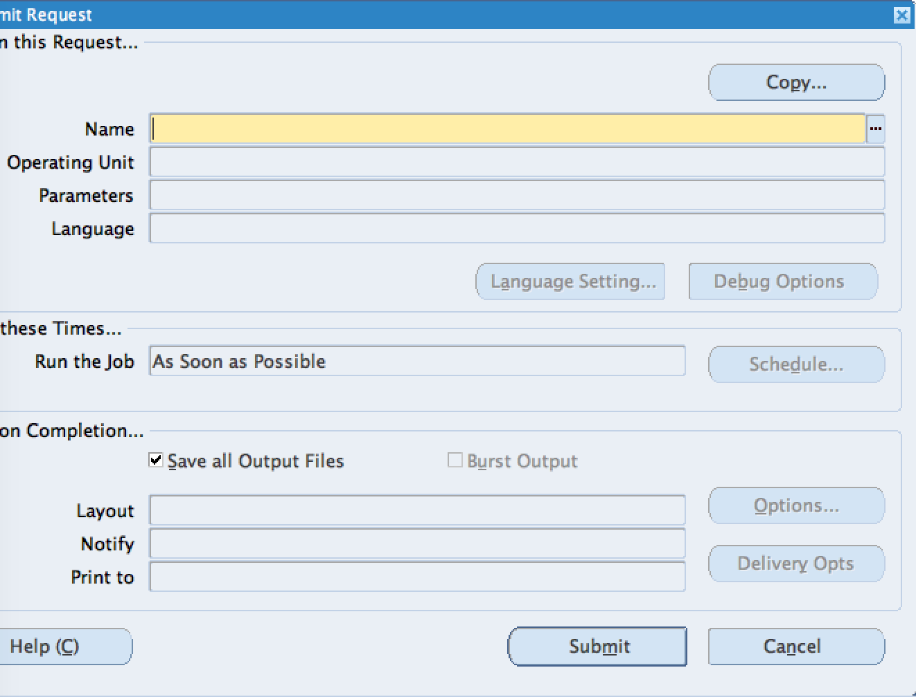
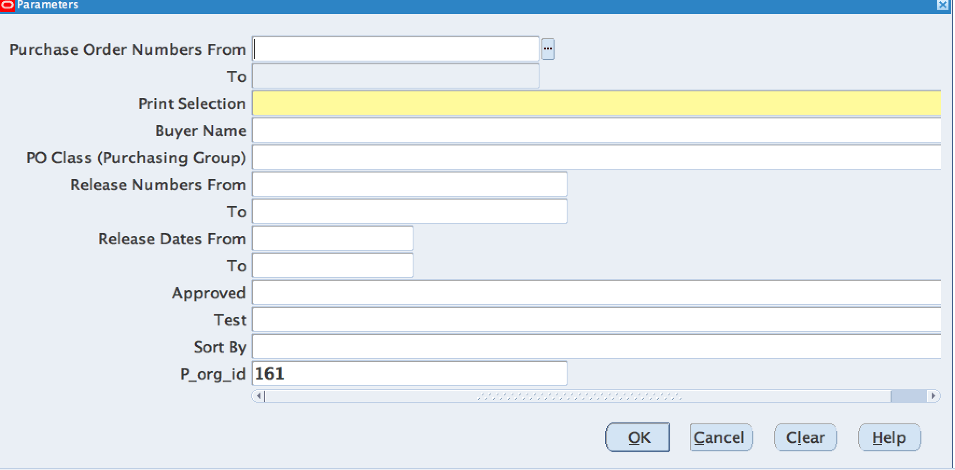
Step 1
Step 2
Step3
ensure not move the location of the screen
OK button (hit): 383 444 (211, 228, 244, 255)
Submit button (check readiness without hit): 475 571 (211, 228, 244, 255)
Name section: click and type (Cisco printed PO report) 449 194 (255, 238, 168, 255)
Hit Enter on keyboard
OK (Check readiness): 908 614 (211, 228, 244, 255)
PO from: type (PO number: 2020271069) 628 200 (255, 255, 255, 255)
TO: click(need to wait and check? What if PO not exist?) 625 229 (234, 239, 245, 255)
Print Selection: type (ALL) 740 260 (255, 250, 156, 255)
Hit OK: 908 614 (211, 228, 244, 255)

Slide 6
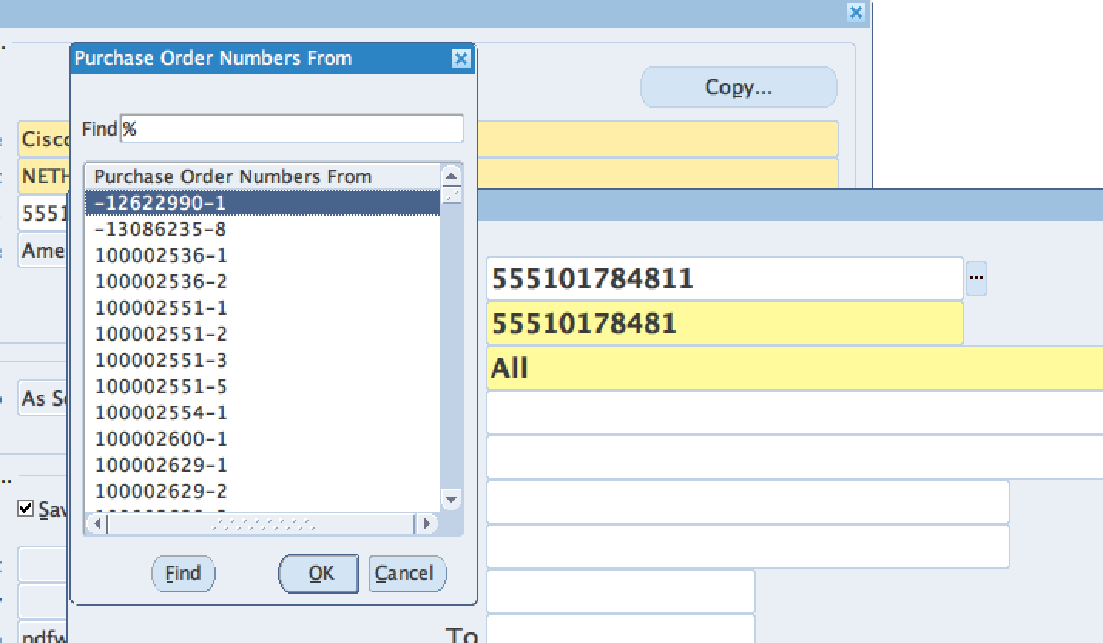
Step 4
Check readiness of TO
If ready, do next,
If To not ready, while new window: click cancel, and go back to Step 3

Slide 7
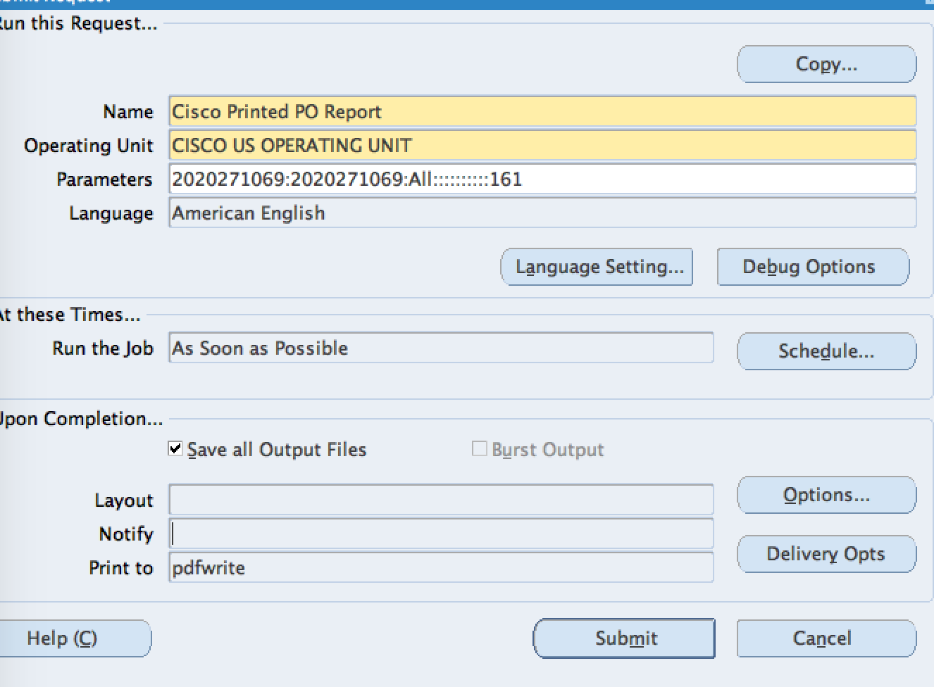
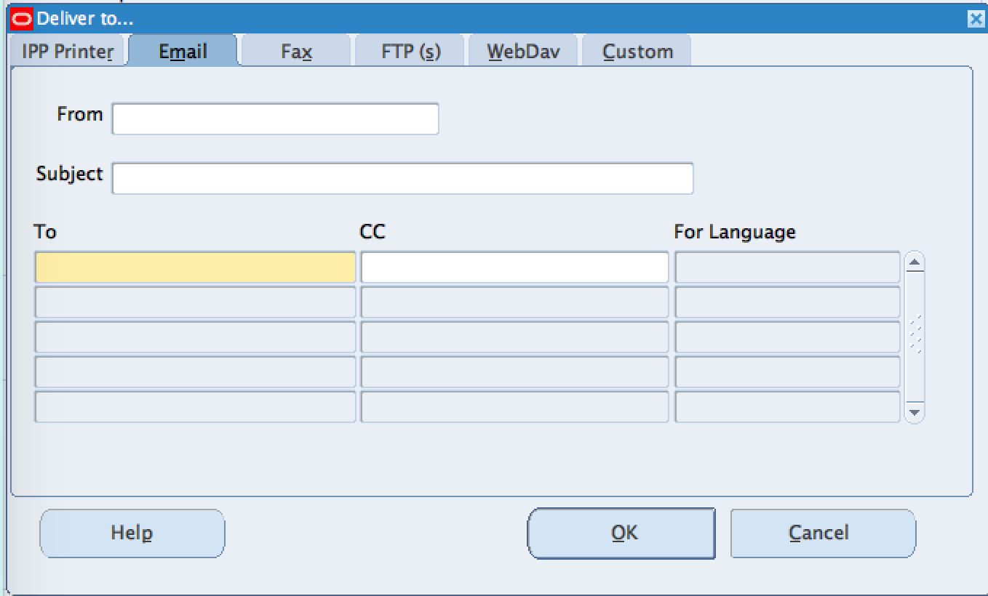
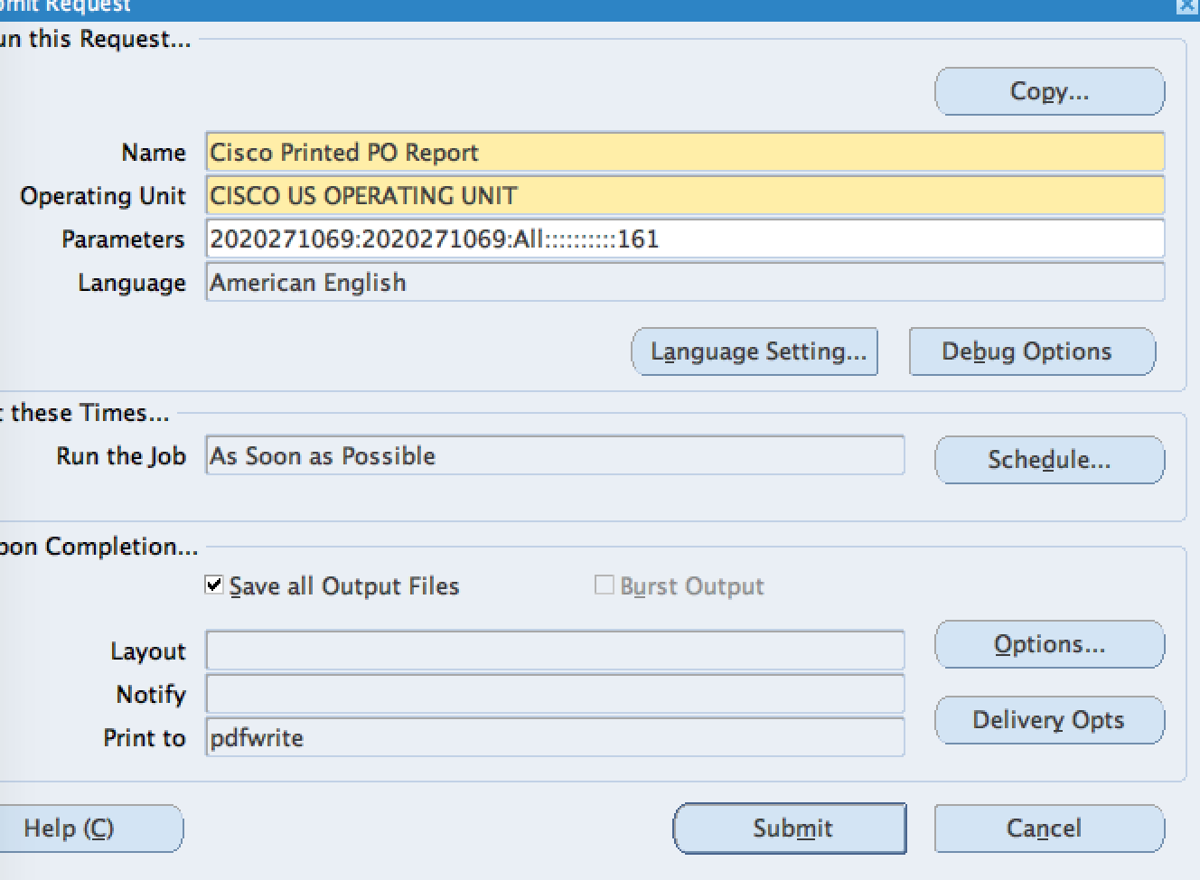
Step 5
Step 6
Step 7
OK (Check readiness)
Email: Click
From: type username
Subject: type PO#
To: click and type (email addresse)
CC: click and type (email address)
OK: click xxx
Submit (check readiness and hit): 475 571 (211, 228, 244, 255)
Delivery Opts (check readiness and Hit):

Slide 8
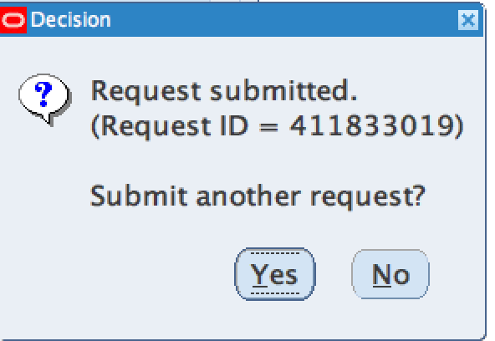
Step 8
If Yes (check readiness): 735 462 (211, 228, 244, 255)
Restart from Step2
If no (check readiness): command+q

